Slide 1

The SCADA Challenge
Developing Industrial Automation Prototypes for research & education at Politehnica University of Bucharest

Slide 2






What is SCADA? (Supervisory Control and Data Acquisition)
Monitor
Control
Acquire & Interface
Gather real-time data from sensors and field devices to visualize operational status.
Supervise and manage industrial processes locally or at remote locations.
Collect and log data for analysis while using HMIs (Human-Machine Interfaces) to interact with machinery.

Slide 3

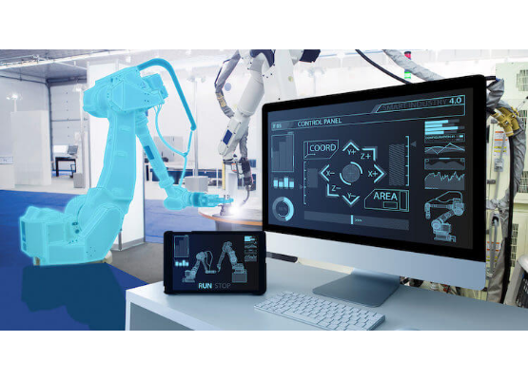
The New Industrial Challenge
Modern industry (Industry 4.0) is more complex than ever. SCADA systems are essential for managing:
•
Renewable Energy Integration
•
Smart Grids & Power Systems
•
Advanced Manufacturing
•
Smart Buildings & Energy Management

Slide 4
The SCADA Challenge at UPB
A focused research initiative at the Politehnica University of Bucharest, engaging students in solving real-world industrial automation problems.
Key Faculties: Faculty of Automatic Control, Faculty of Electronics, Faculty of Energy Management, Faculty of Mechatronics, etc

Slide 5
Program Objectives
Bridge Theory and Practice: Move from academic concepts to functional, real-world systems.
Drive Research: Provide a platform for developing and validating novel control and monitoring strategies.
Build Prototypes: Create tangible, working prototypes that can be tested in live environments (anything that can work at small scale & to be integrated in a smart building)
Innovate: Develop open-source, cross-platform solutions for modern industrial challenges.

Slide 6
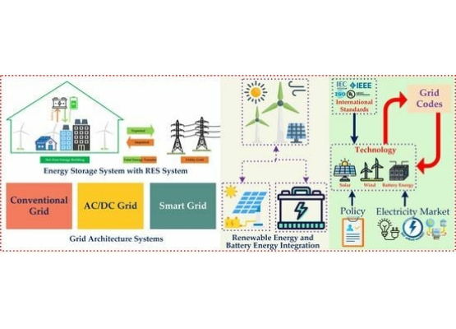
Focus: Smart Energy Systems
A primary challenge is managing modern power systems. Students are developing SCADA solutions to handle:
•
Load balancing with renewable sources (Small Scale Power Plant)
•
Real-time grid monitoring.
•
Energy quality and efficiency.
•
Smart building energy management.

Slide 7
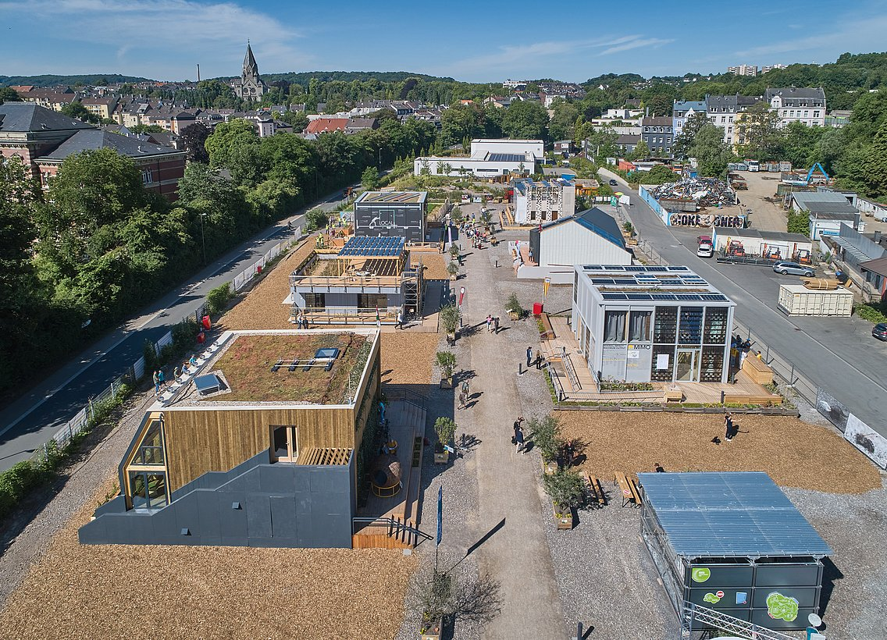

Prototype in Action: Smart Living Lab
Bucharest Demo Site
A key project involving UPB student & researchers is the Bucharest demosite for a Smart Living Lab.

Slide 8


From Research to Reality: Why Prototypes?
For Research
For Students
•
Validates new algorithms.
•
Develops practical engineering skills.
•
Provides real-world data.
•
Solves tangible problems.
•
Tests system stability & security.
•
Creates impactful thesis work.
•
Leads to practical, publishable results.
•
Prepares for high-level industry roles.

Slide 9






Core Technologies
PLCs/RTUs
HMI Software
Data Historians
Network Protocols
Interfacing with physical hardware and sensors.
Designing user interfaces for operation and control.
Managing and logging time-series data for analysis.
Ensuring device communication (e.g., Modbus, OPC UA).

Slide 10
Research Accelerator
"This initiative allows master degree or PhD candidates to not just theorize, but to build, test, and deploy systems that solve the next generation of industrial challenges."
"
"

Slide 11


Are You Ready for the Challenge?
This program is for students passionate about:
Get Involved
For more information, contact the Smart Living Lab@UPB (https://www.github.com/smartlivinglab)
•
Industrial Automation
•
Control Systems
•
Software Development
•
Energy Engineering

Slide 12
Questions?
Drd.Ing.Contol Eng. Marian Banica (412)
Thank You

Slide 13




Image Sources
https://www.automationreadypanels.com/wp-content/uploads/2024/01/Human-Machine-Interface-HMI-750x400-1.jpeg
Source: www.automationreadypanels.com
https://pub.mdpi-res.com/energies/energies-18-02221/article_deploy/html/images/energies-18-02221-ag-550.jpg?1746178523
Source: www.mdpi.com
https://nzeb.in/wp-content/uploads/2015/08/geothermal-V2.jpg
Source: nzeb.in

